Slide 1
Propose a deep learning architecture

Slide 2
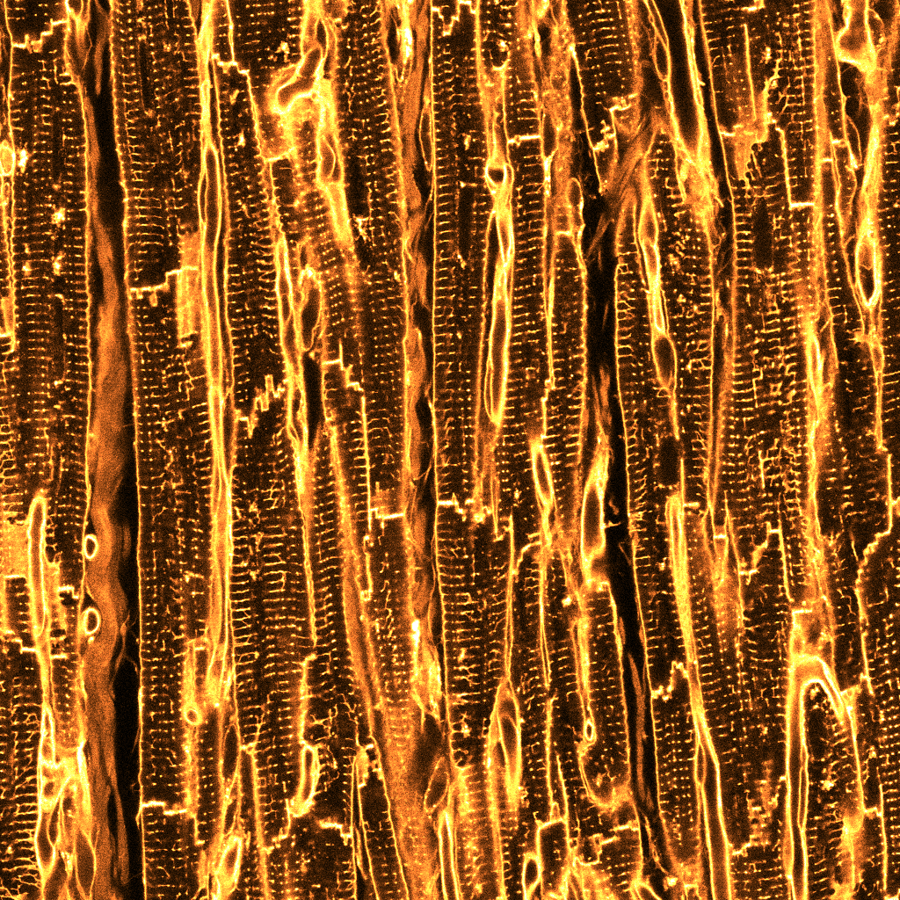

Separate cells in 3D

Slide 3
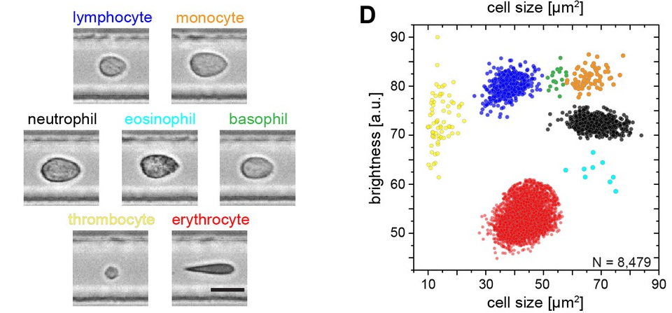
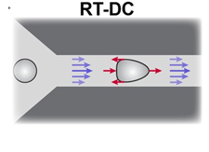
Sort cells

Slide 4
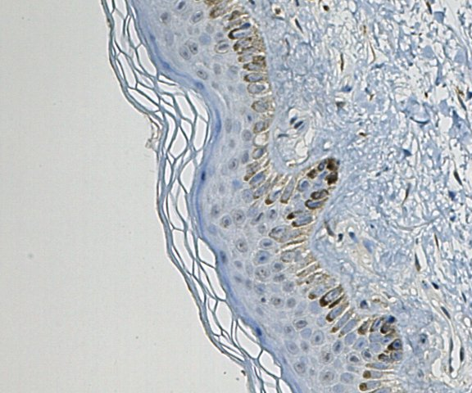
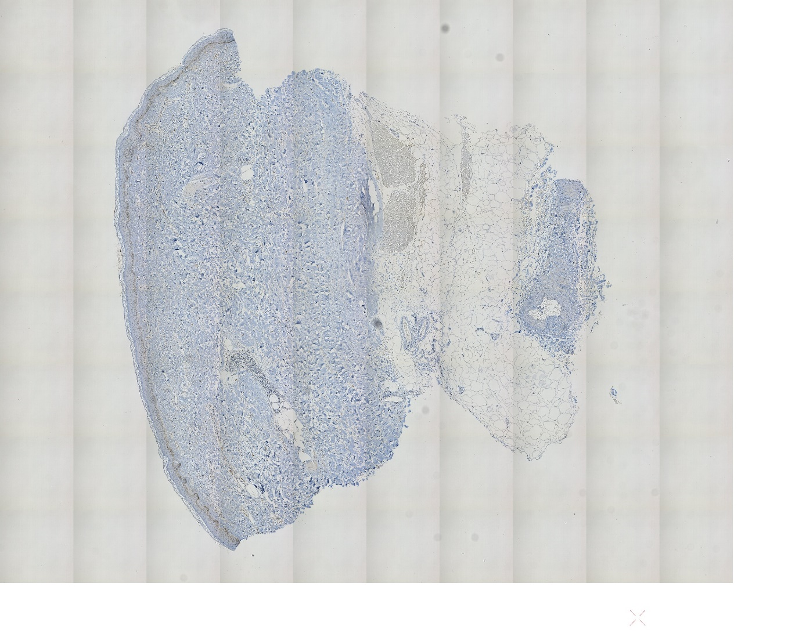

Count cells

Slide 5
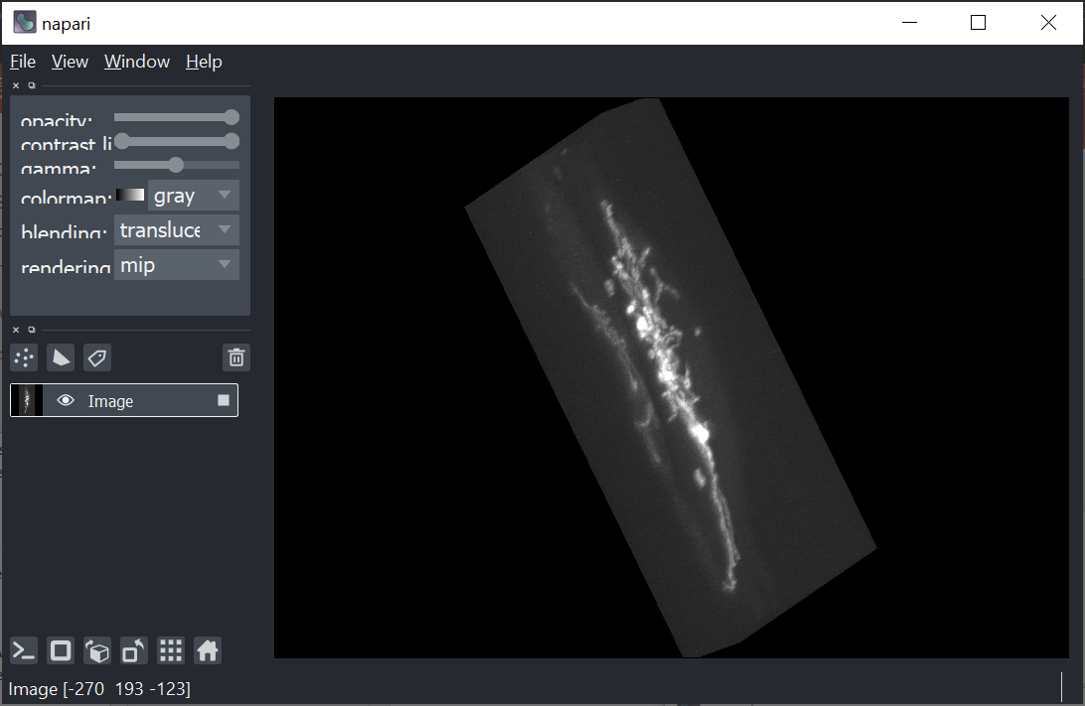
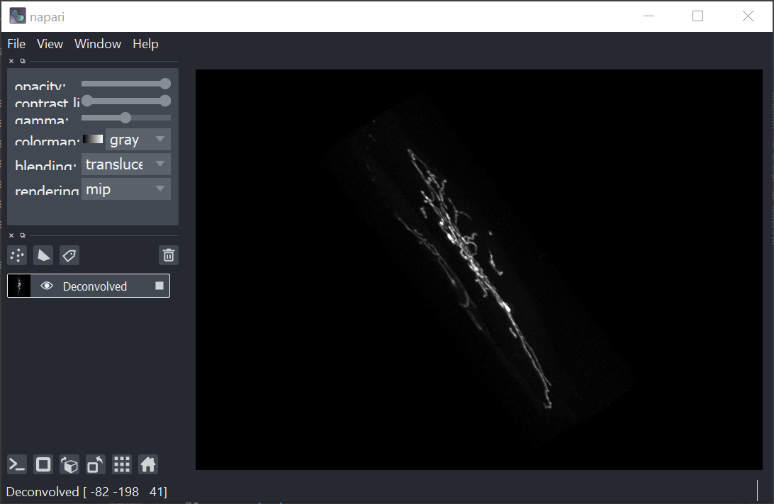
Deblur images in 3D

Slide 6
Sort Bacteria
Positives
Negatives

Slide 7
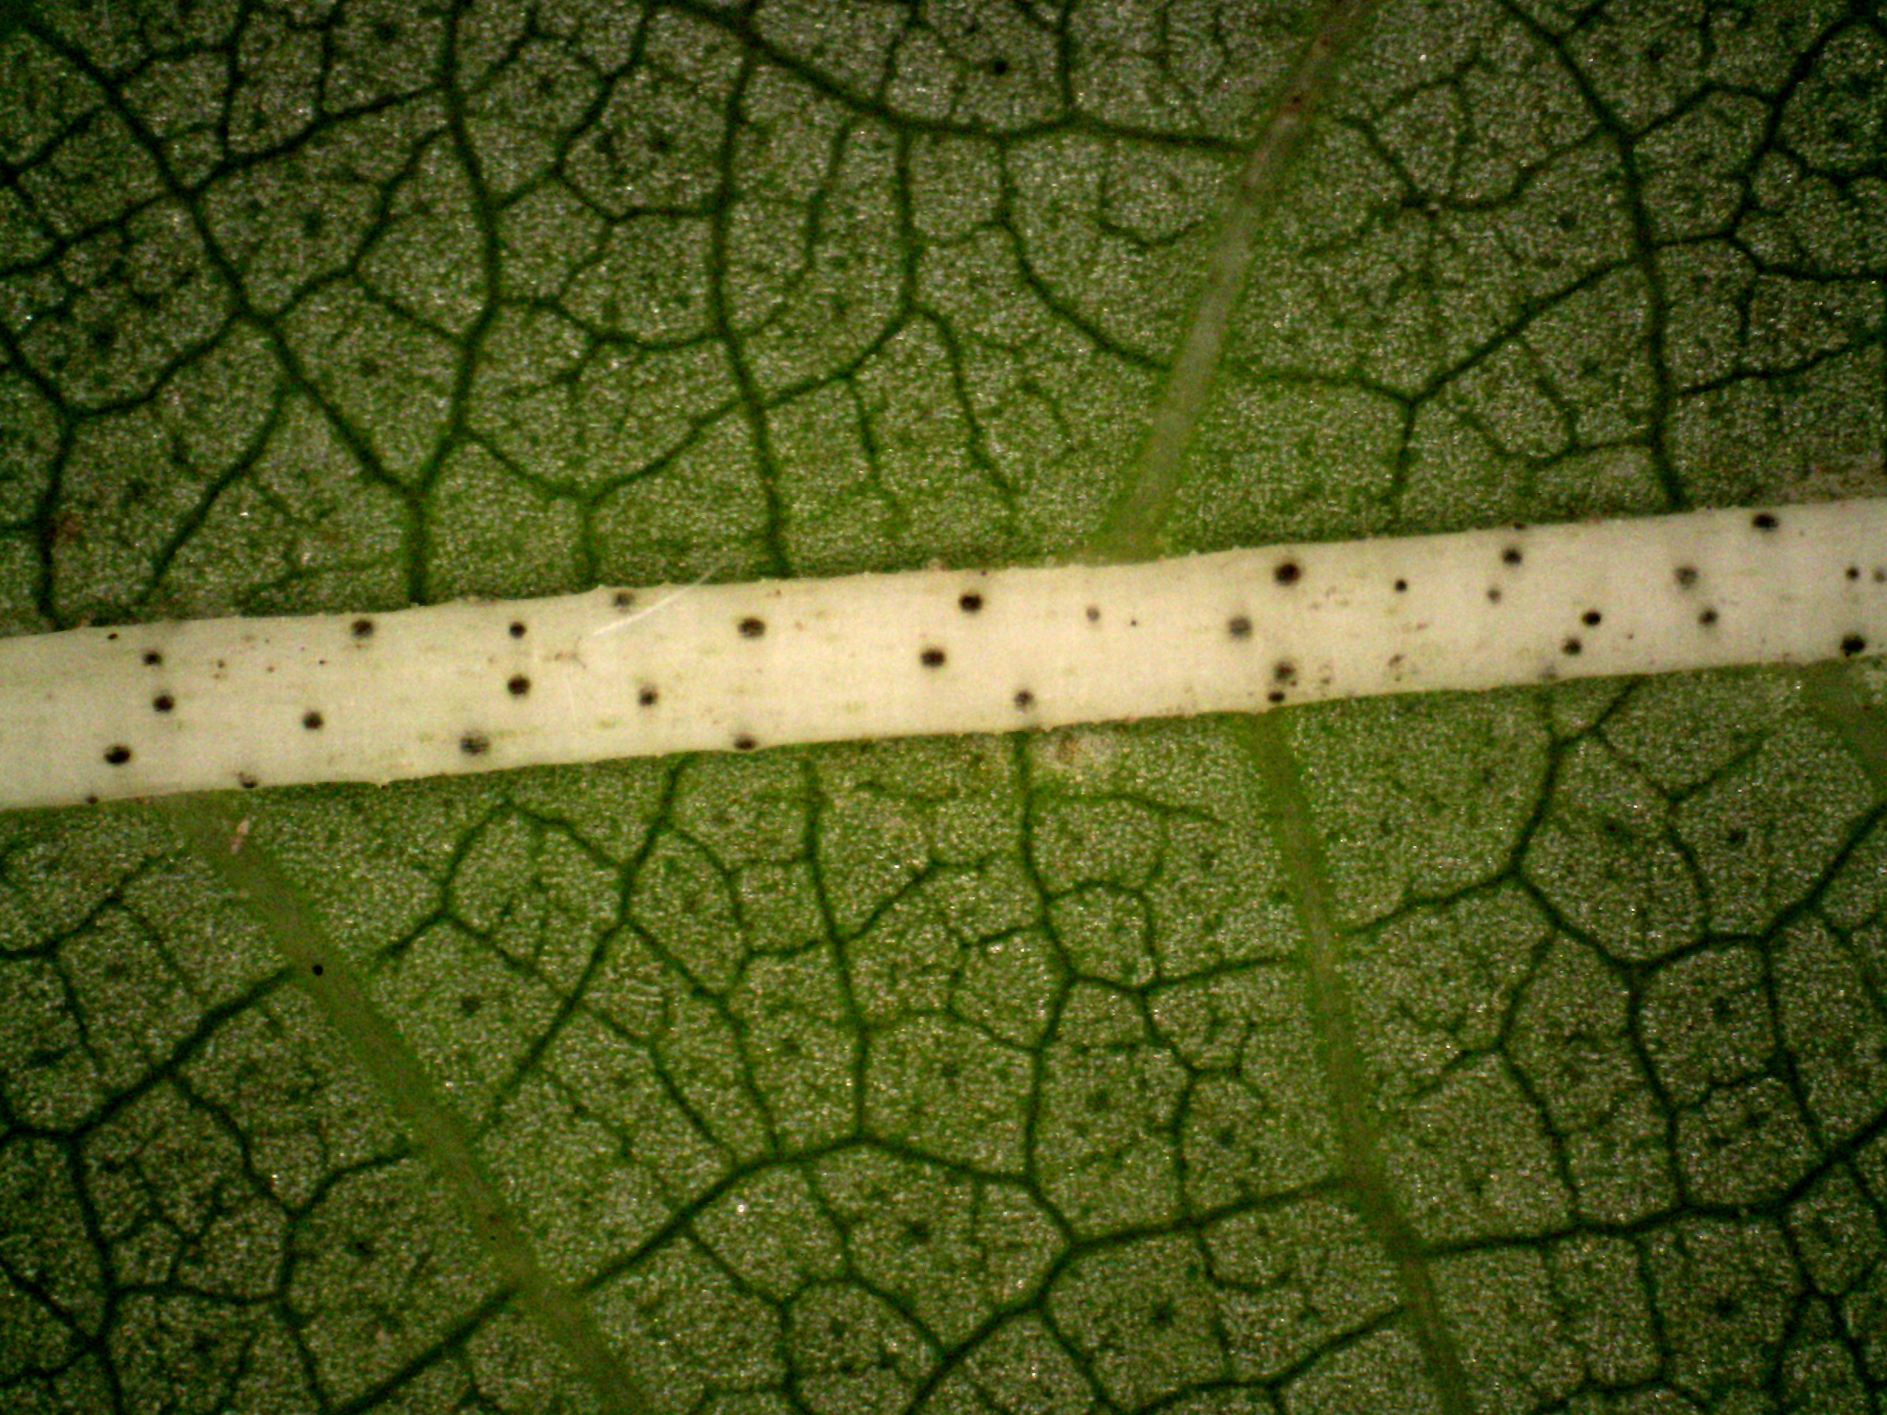
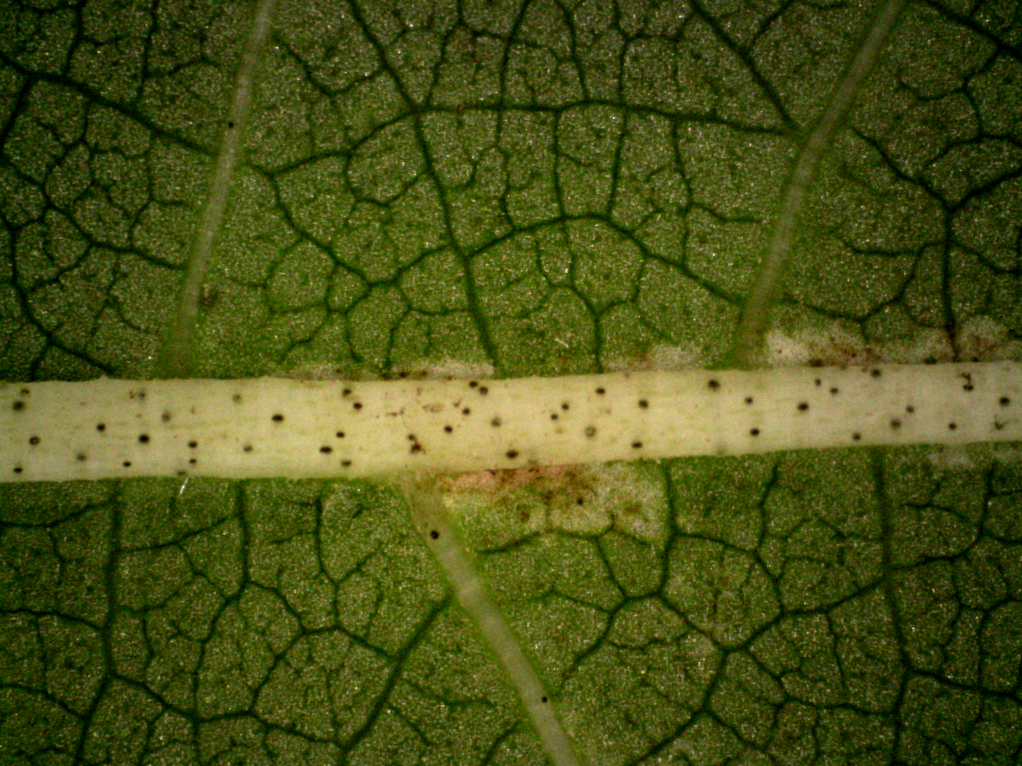
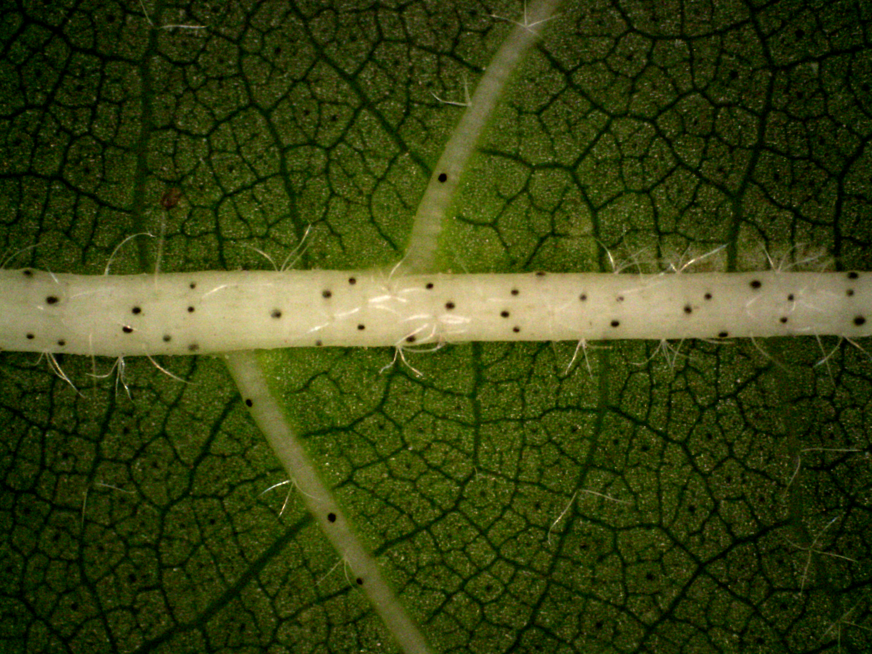
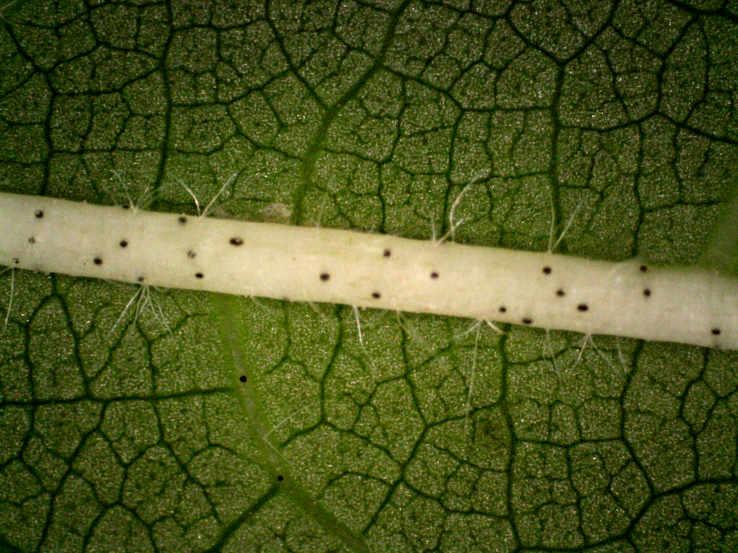
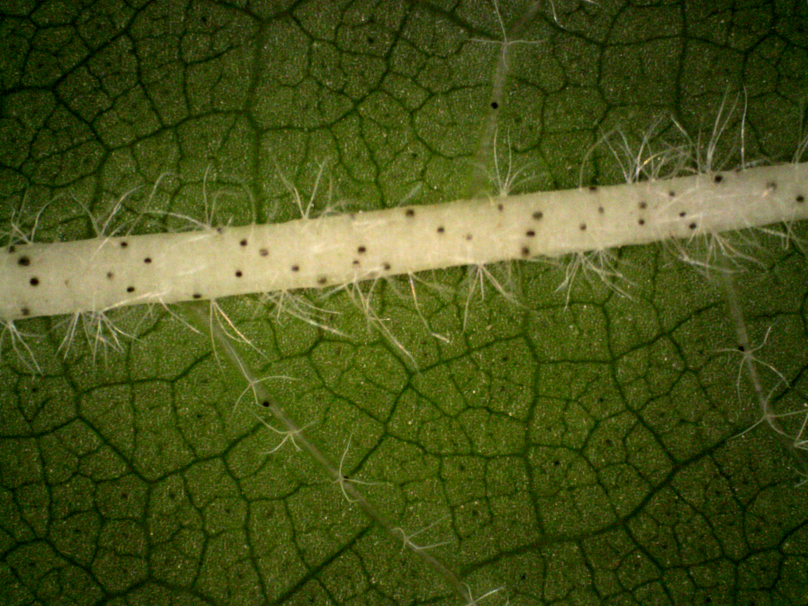
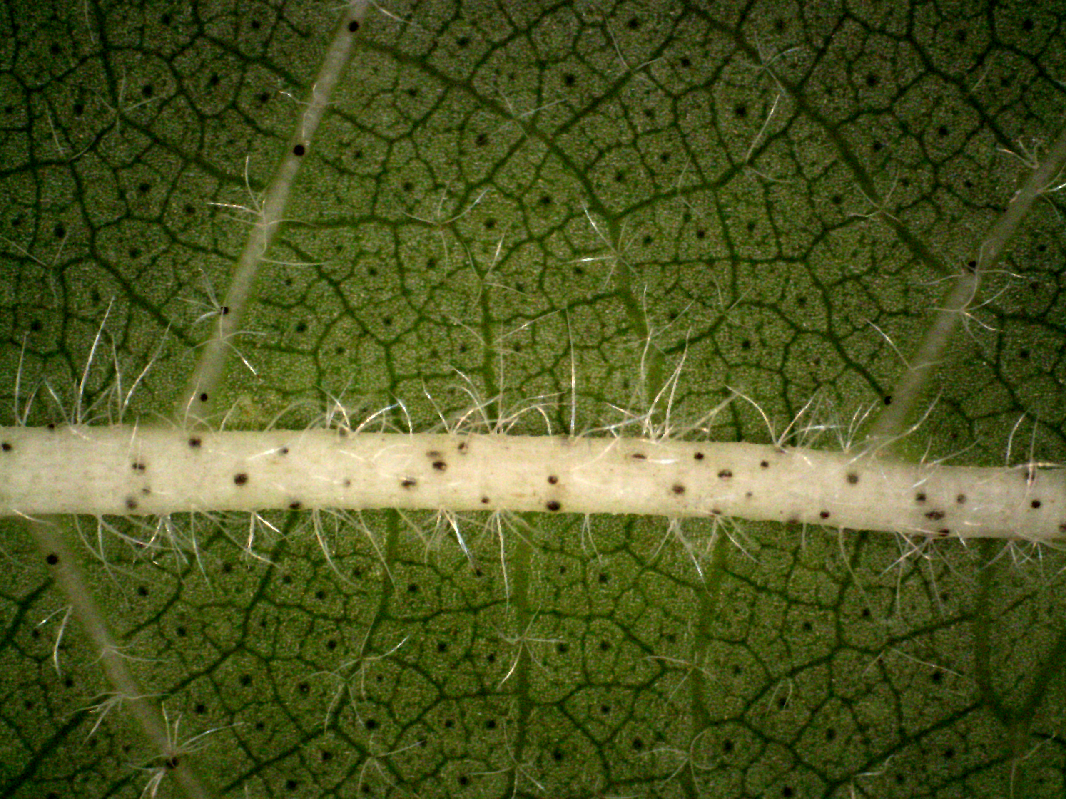
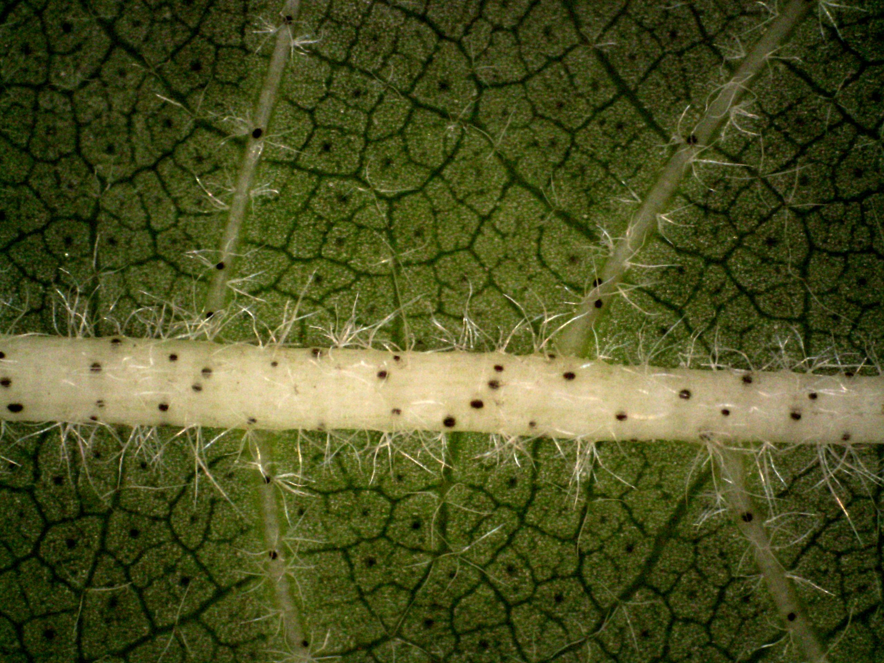
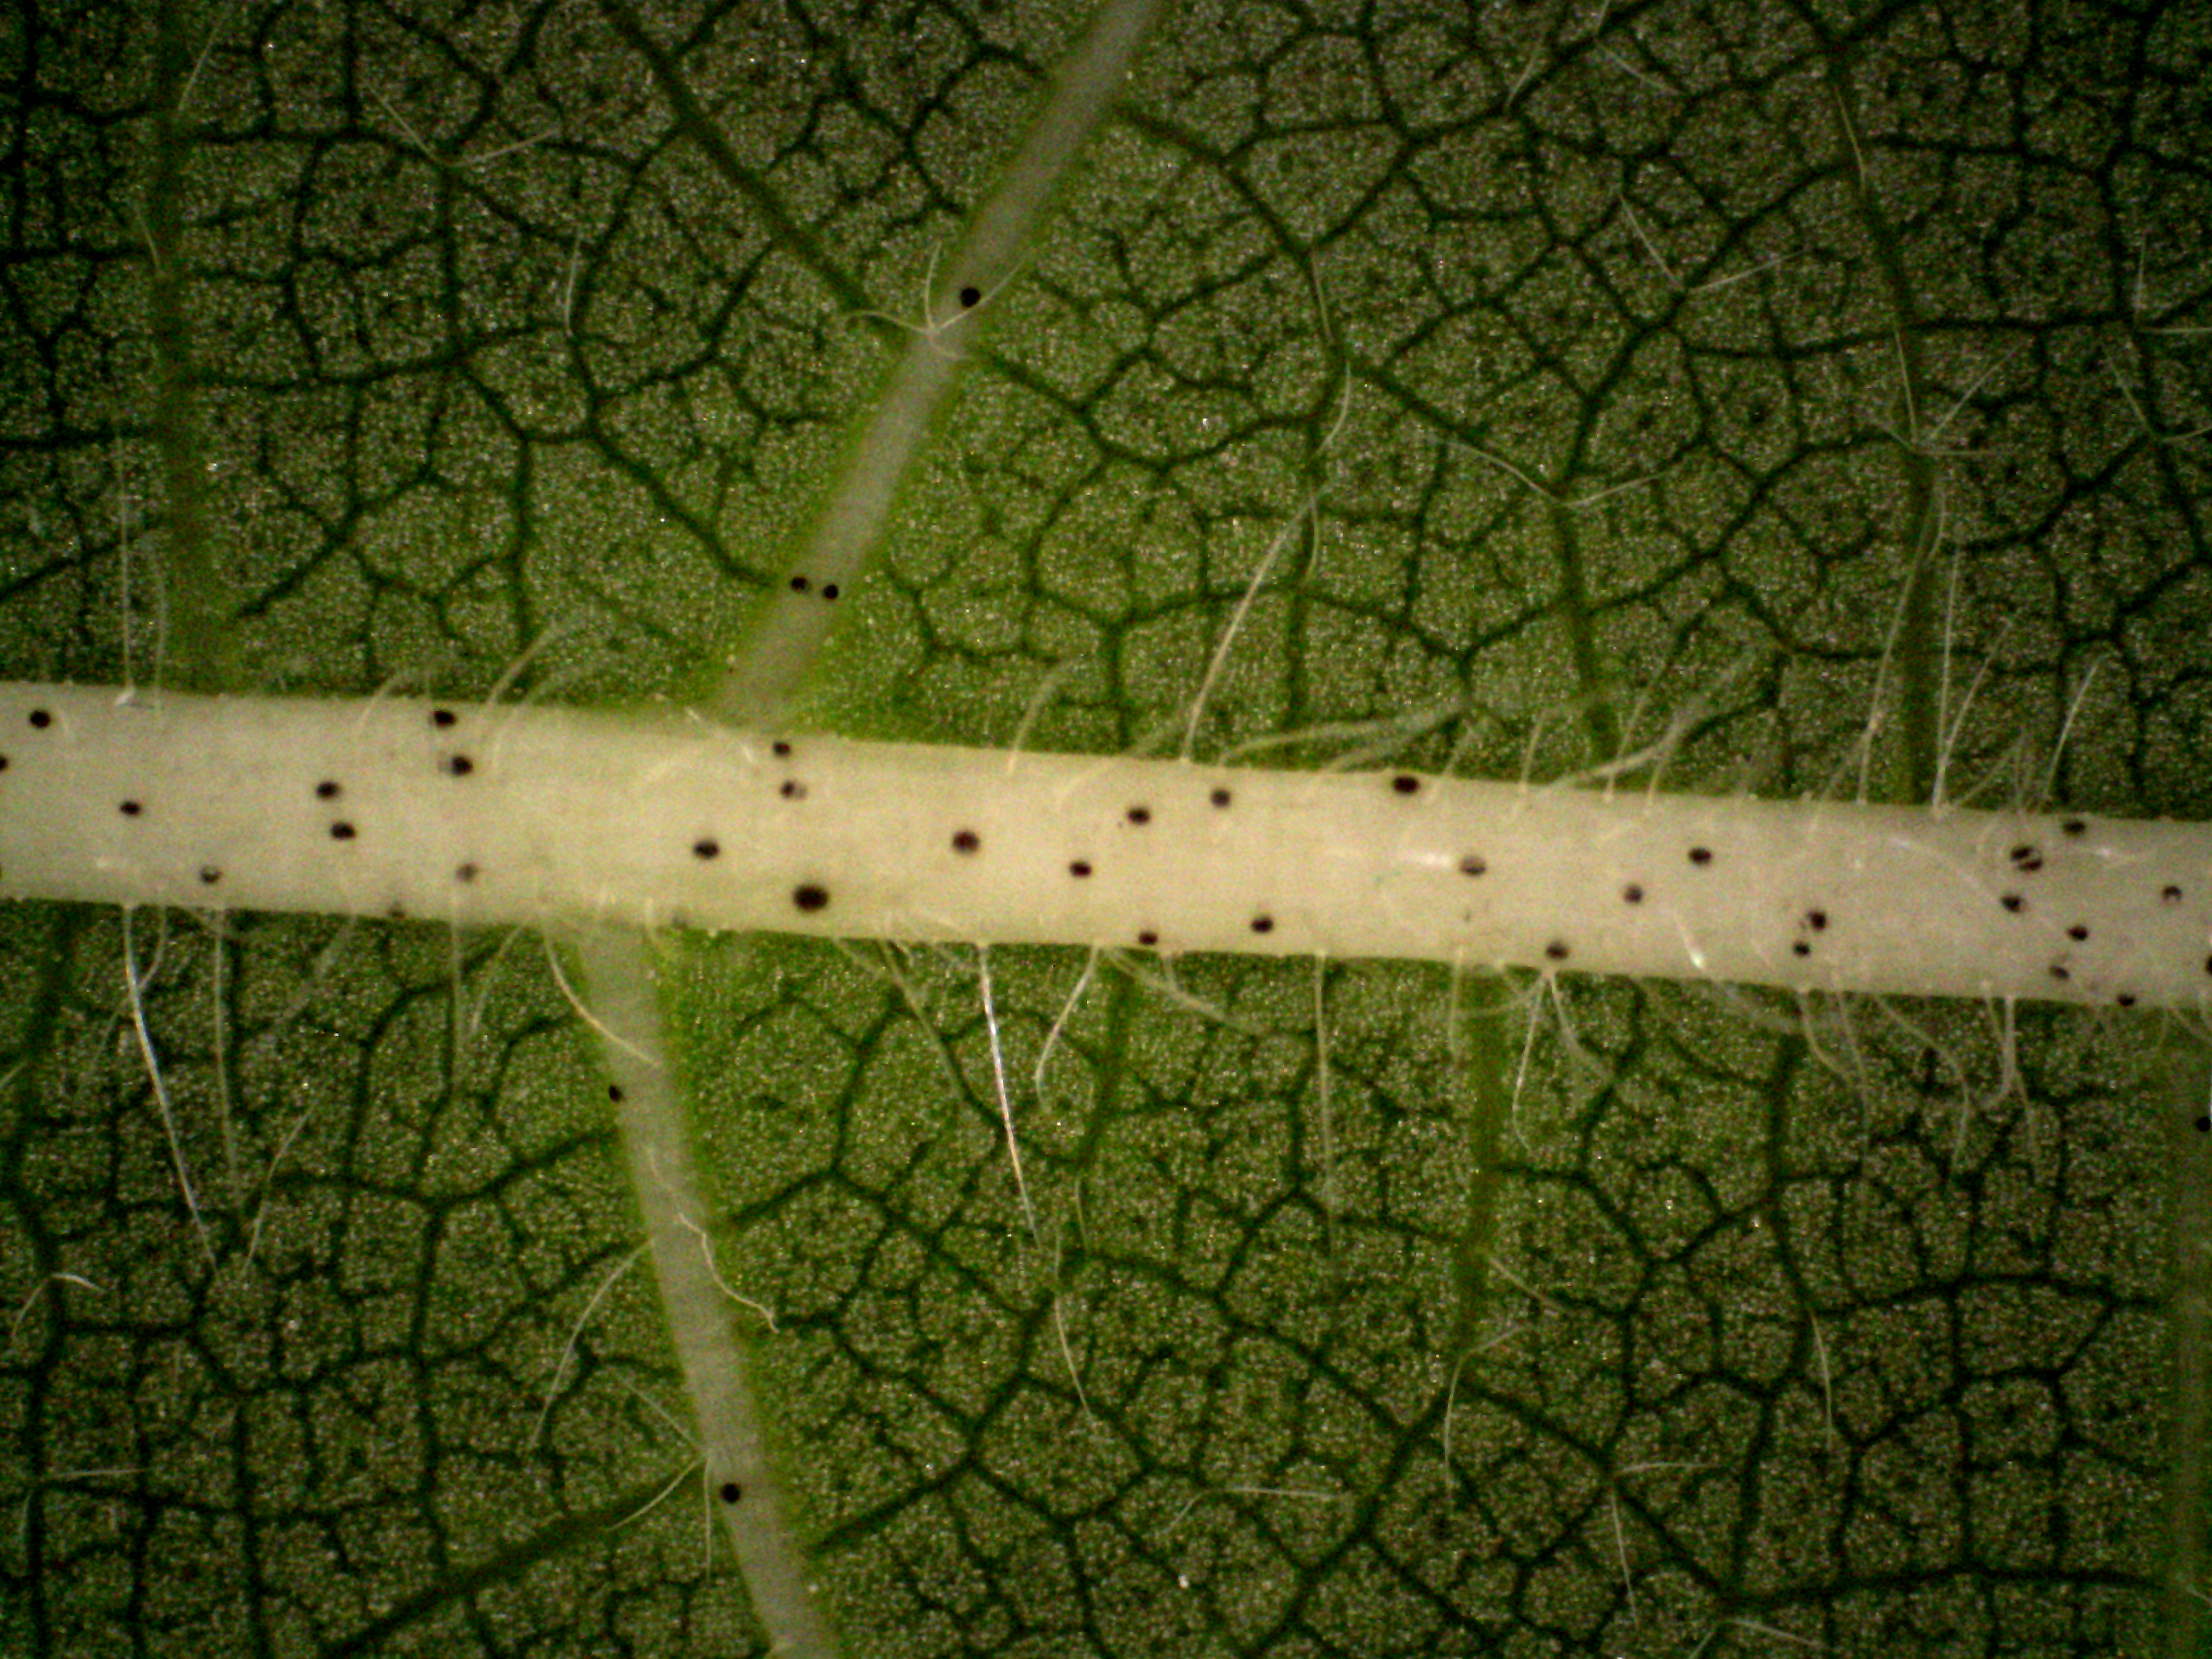
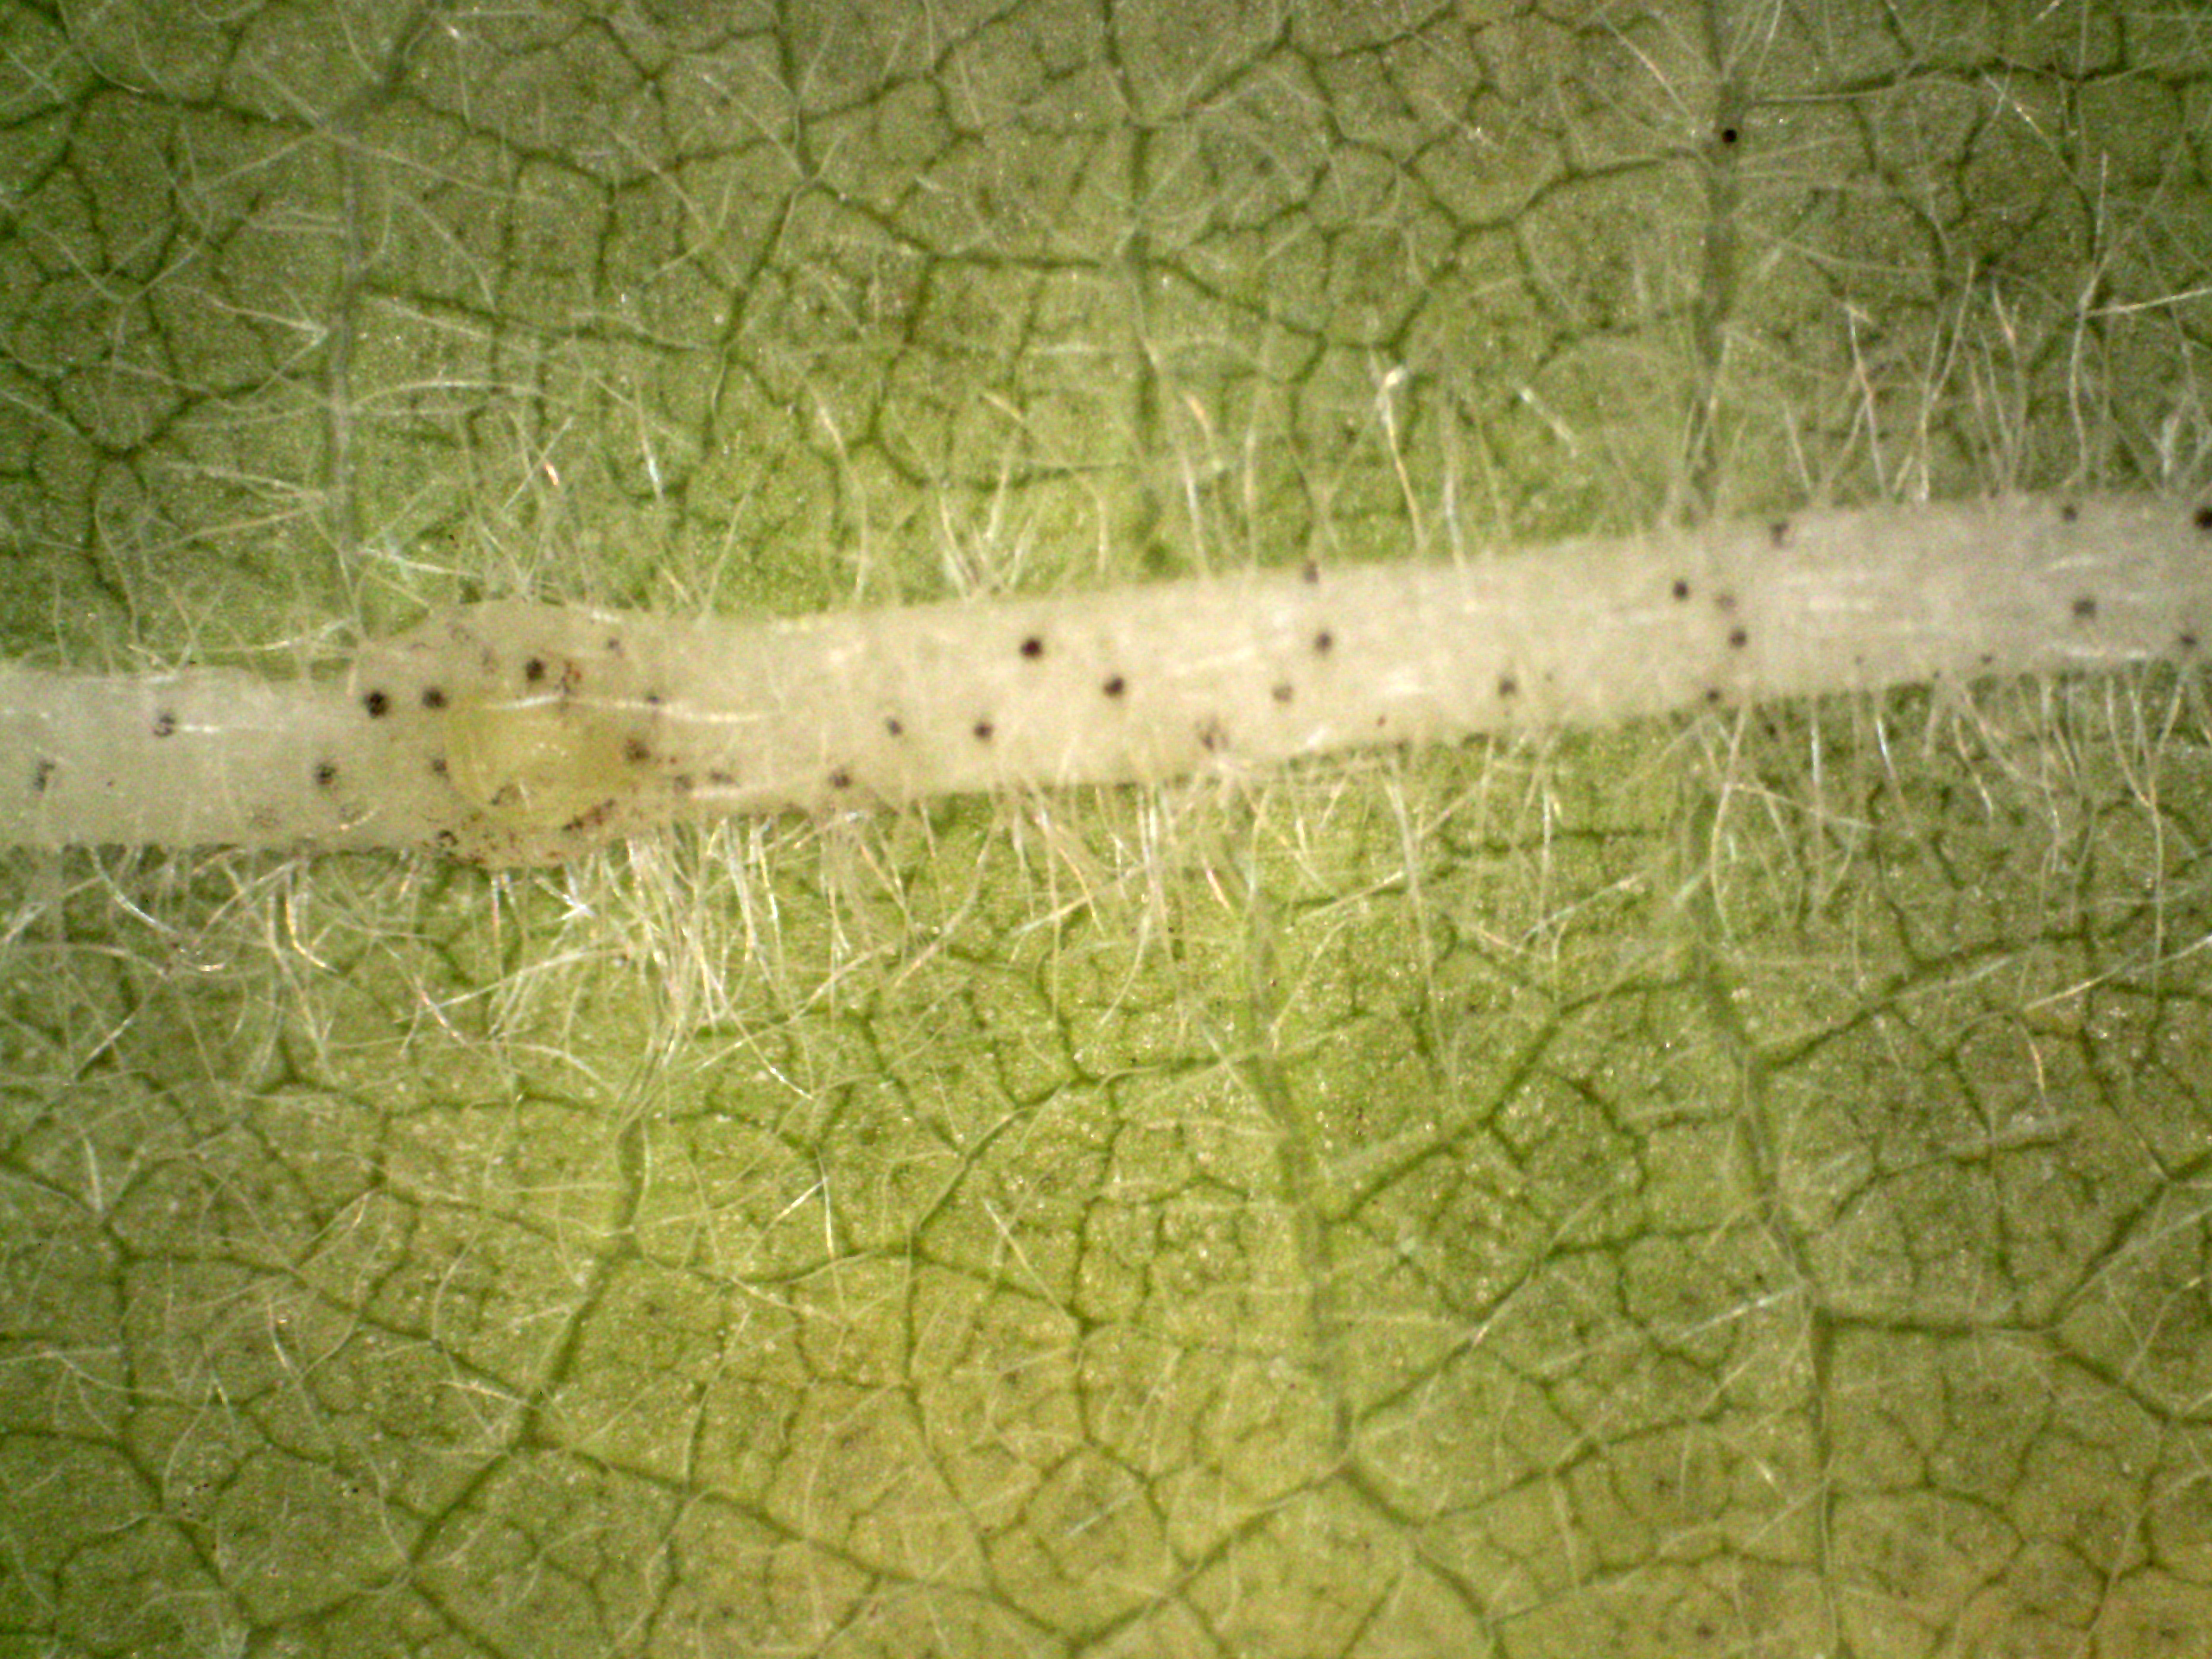
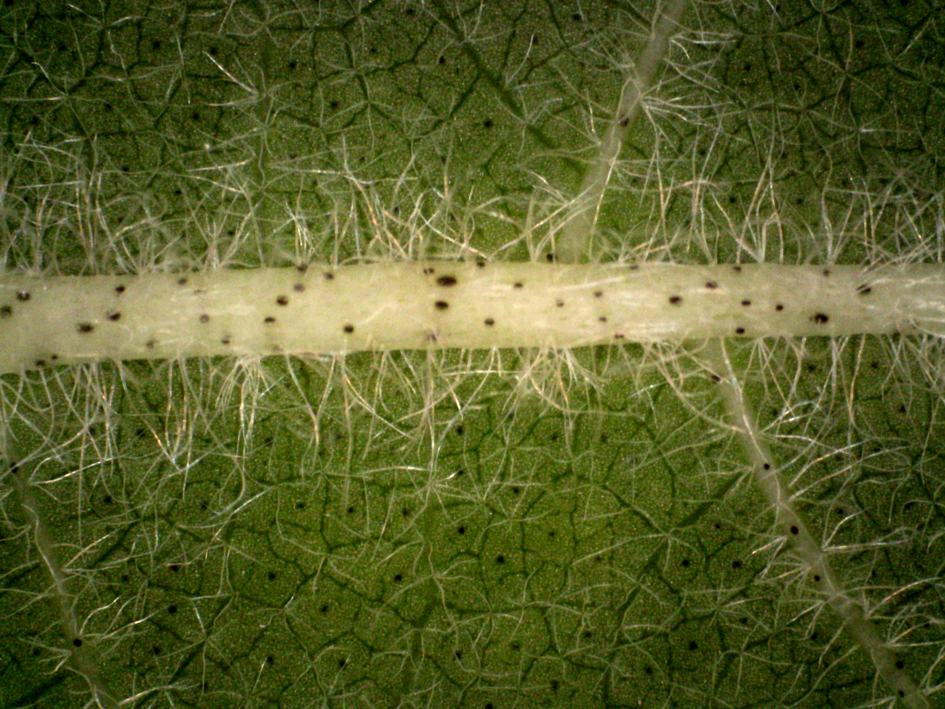
Sort Hairiness of surfaces
Line1
Hairiness: 1
Line2
Hairiness: 1
Line3
Hairiness: 3
Line4
Hairiness: 3/4
Line5
Hairiness: 4
Line6
Hairiness: 4/4+
Line8
Line9
Line10
Hairiness: 5+
Line7
Hairiness: 4+
Hairiness: 4+
Hairiness: 5+

Slide 8
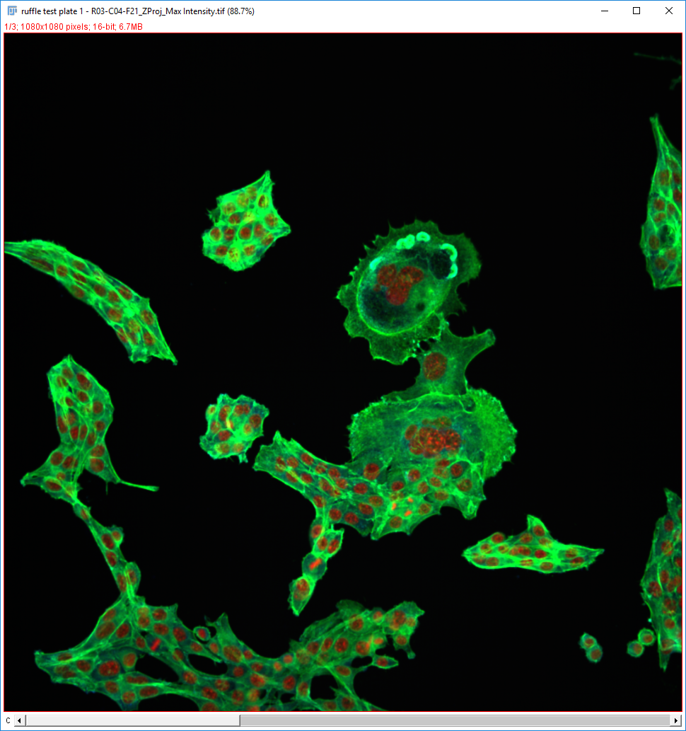
Isolate dorsal cells in 16 bits images

Slide 9
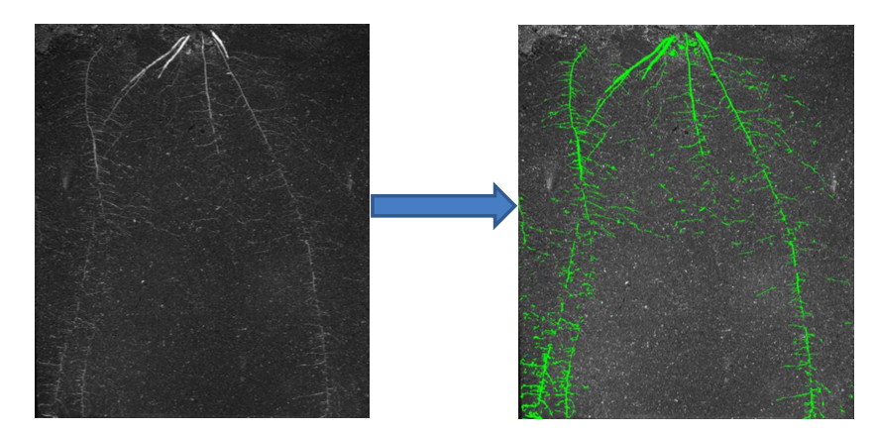
Extract root from soil numerically

Slide 10
isotropic restoration of 3D volumes

